Slide 1


ITE-7101: COMPUTER PROGRAMMING
AMA Computer University
Master of Science in Computer Science
Course Project Presentation
Presented By: Ramon Villamangca
Notes:
Good day, this is Ramon Villamangca. Today I am going to present to you the course project for ITE-7101 Computer Programming. ITE-7101 is one of the prerequisite courses required for graduate program MS Computer Science in AMA University. <click>

Slide 2


Presentation Outline
Part 1 | C++ Topical Presentation
Through the Loops
Dimension of Data Types
Introduction to Function Procedures
Part 2 | Programming Exercise Video
Prerequisite Topics to Part 2
Solution to Programming Exercise
Notes:
This presentation comprises of 2 parts. <click> The first one is the Topical Presentation. <click> And, part 2 is the Programming Exercise. <click>
The first part has 3 sections: (1. Through the loop…). I chose this topic because I am for the most part a functional programmer and most of the concepts in modern C++ is in the focus in replacing loops with functional approaches, introduction of new and more specific data types and the focus on FP rather than OOP. <click>
Part 2 has 2 sections. The first section is a rundown of prerequisite topics needed for our exercise solution. These are concepts that are not taught in the course module and would give us a more modern approach to our solution. The second section is the actual video of our solution.
With that let’s start our journey! <click>

Slide 3
Part 1: Topical Presentation
1. Through the Loops
Loops is programming flow control mechanism that allows a code block to be executed repeatedly, in the process called “iteration”.
Types of C++ Loops
C++ provides for both imperative and functional constructs of looping:
Imperative Loops:
Imperative For Loop
While Loop
Do-While Loop
Functional Loops:
Range-based For Loop
For-Each Loop
Notes:
(Loops is a programming…) <click> (C++ provides for both…) We will discuss both of this constructs. <click>. The imperative loops in C++ are: (Imperative…). <click>. While the functional loops are: (Range…). These are called “functional” because it tries to adhere to adhere the functional principle of “no side effects”. I will explain it when we get there. <click>

Slide 4
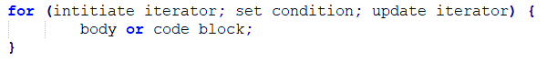
Part 1: Topical Presentation
1. Through the Loops
Imperative For Loop
Imperative For Loop is type of looping in which the number of iteration is clearly mentioned before the start of iteration. The code syntax is as follows:
An example will make this clearer.
Notes:
Now, we begin with Imperative For Loop. <click>. (Imperative…) <click>. For loops starts with the keyword “for” followed by the following inside parenthesis: the initial value of the iterator, a conditional statement stating the limit of iteration and the modification to be made to the iterator in each step of the iteration. All the parameters inside the parenthesis are separated by semicolon. This is then followed the code block (loop body) intended to be repeated, enclosed in curly braces. <click>. (An example…) <click>.

Slide 5
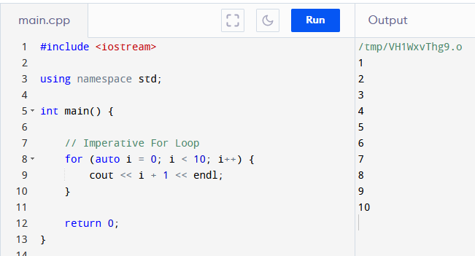
Part 1: Topical Presentation
1. Through the Loops
Imperative For Loop (Example)
Notes:
So in For loop. We first initiate the iterator. <click>. In this case i=10. (Don’t worry about the keyword “auto”, I will discuss it when we get to part 2).
Then we set the condition or limit. <click>. That is i<10. Then we tell the loop how to update the iterator in each step of iteration. <click>. That is increment by one. And then <click> we go to the loop body which tells the program what to do while the condition is still met. In this case print the value of i+1. <click> The output is the program prints numbers from 1 to 10 to the screen. <click>.

Slide 6
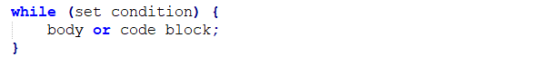
Part 1: Topical Presentation
1. Through the Loops
While Loop
While Loop is type of looping in which the loop body will only be executed “while” certain condition is still satisfied. If the condition failed, the loop terminates. The code syntax is as follows:
An example will make this clearer.
Notes:
Next we discuss while loops. (While Loop…) <click>. While loops starts with the keyword “while” followed by the condition to “continue” the loop, inside parenthesis, followed by the code block (loop body) intended to be repeated, enclosed in curly braces. It can also support iteration, but the iterator must be declared before the start of the while-block. <click> (An example…) <click>.

Slide 7
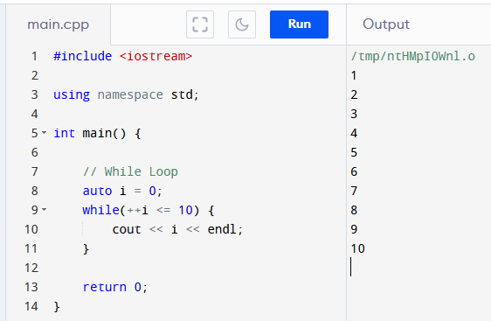
Part 1: Topical Presentation
1. Through the Loops
While Loop (Example)
Notes:
So in while loop. If there is an iterator (in this case “i”) we first initiate it “i=0” <click>. Then we set the condition <click>. In this case increment i and compare to 10. <click> And then <click> we go to the loop body which tells the program what to do while the condition is still met. In this case print the value of i. <click> The output is the program prints numbers from 1 to 10 to the screen. <click> <click>.

Slide 8
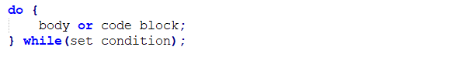
Part 1: Topical Presentation
1. Loops in C++
Do-While Loop
Do-While Loop is variation of the While Loop wherein the conditional statement is at the end of the code block. The code syntax is as follows:
An example will make this clearer.
Notes:
(Do-While…) <click>. Do-While loops starts with the keyword “do”, followed by the code block (loop body) intended to be repeated, enclosed in curly braces, followed by the “while” condition to “continue” inside parenthesis. Note that the “while” condition needs to be terminated by a semi-colon (;). Having the loop body in front of the condition, ensures that the body will execute at least once. <click> (An example…)

Slide 9
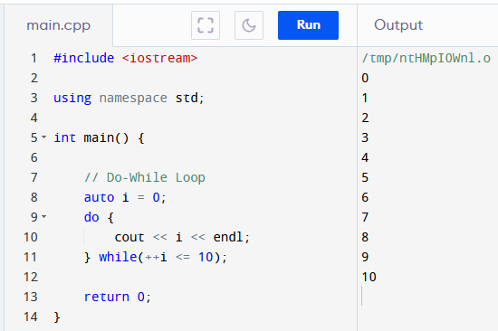
Part 1: Topical Presentation
1. Loops in C++
Do-While Loop (Example)
Notes:
As in while loop. If there is an iterator (in this case “i”) we first initiate it “i=0” <click>. Then <click> we go to the loop body which tells the program what to do while the condition is still met. Then we set the condition at the end of the block<click>. In this case increment i and compare to 10. <click> And In this case print the value of i. <click> The output is the program prints numbers from 0 to 10 to the screen. <click>. The output is different from while loop <click> although they have the same condition. This is because in do-while <click> the body is run first before the condition. Allowing it to print “i” before it is ever updated. <click>

Slide 10
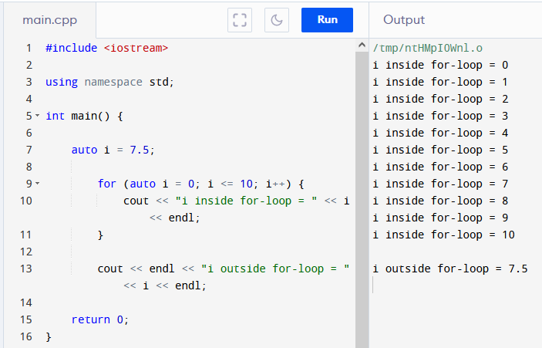
Part 1: Topical Presentation
1. Loops in C++
Scope and Variable Lifetime
A local variable is only valid in the code block it resides on. The validity of a local variable within a code blocks is called its scope.
Variables created inside a loop, lose their scope when the loop ends.
Notes:
Before we continue with the other loop types, we first discuss a few important concepts. First we have <click> (Scope and…) . We also say that the local variable has a lifetime only up to it gets out of scope. Variables are just locations in memory. When a variable goes out of scope the memory allocated to it in the block is freed for use of other processes. <click>
In this example the variable “i” inside the for-block <click> is not the same as the variable “i” outside <click>. As we can see <click> the value of variable “I” inside the block is increasing while the outside “I” value remains the same.
Since the loops we learned so far are essentially code blocks, we need to know that, <click> (Variables…) This is the reason why While-Loops are not recommended to do iteration as the iterator has to be declared outside the loop’s code block. That means the iterator memory allocation is not released when it gets out of scope. Leaving us with an extra variable that we may or may not be able to reuse.

Slide 11
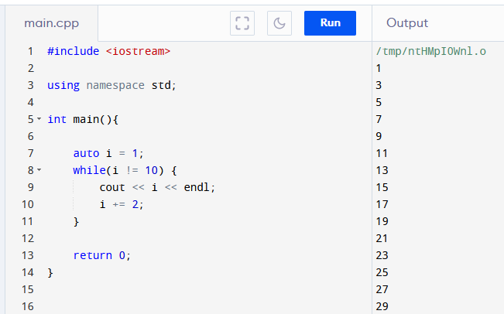
Part 1: Topical Presentation
1. Loops in C++
Infinite Loop
The situation wherein the terminating condition can never be satisfied and therefore the loop cannot terminate, is called Infinite Loop.
Notes:
Loops rely on conditions and limits in order in order to terminate. A well-designed loop should terminate gracefully when the terminating conditions are met. This is not always the case, though. <click> (The situation…) In an infinite loop goes on and on and until your program crashes. This is very bad for your program… and maybe your refutation. So, infinite loop should avoided as much as possible.
<click> (Example) In this example the condition <click> cannot be attained because “I” is only having odd integer values. In the online compiler I am using the program stops when “i=5999”. But on a real app this can potentially run longer than that and eventually it will crash.
There is some use though, for infinite loop however you must know how to exit from infinite loop, which we will discuss in the next slide.

Slide 12
Part 1: Topical Presentation
1. Loops in C++
Break and Continue Statements
Break statement halts the execution of all statements inside the loop, after the “break” and terminates the loop completely.
Continue statement halts the execution of all statements inside the loop, after the “continue” and returns to the start of the loop.
An example will make this clearer.
Notes:
There is a way to prematurely halt the execution of a loop. This is through the use of Break and Continue Statements. <click> (Break…) Break is also use to handle cases in a switch statement but that is outside the scope of this presentation. <click> (Continue…) That means that in this case the loop does not terminate but start over again to the next iteration. <click> (An example…) <click>

Slide 13
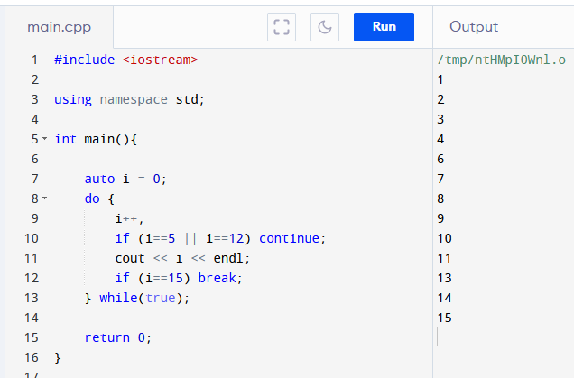
Part 1: Topical Presentation
1. Loops in C++
Break and Continue (Example)
Notes:
In this example, the do-while is potentially an infinite loop. This is because the condition <click> is always “true” and can never be changed. However, because we have this <click> condition and break statement, the loop will terminate at “i=15”. Also because of this <click> continue statement before the call to cout, the program will not print 5 and 12 in the screen, and instead shall continue to the next iteration.

Slide 14
Thank YOU!!!

